Slide 1
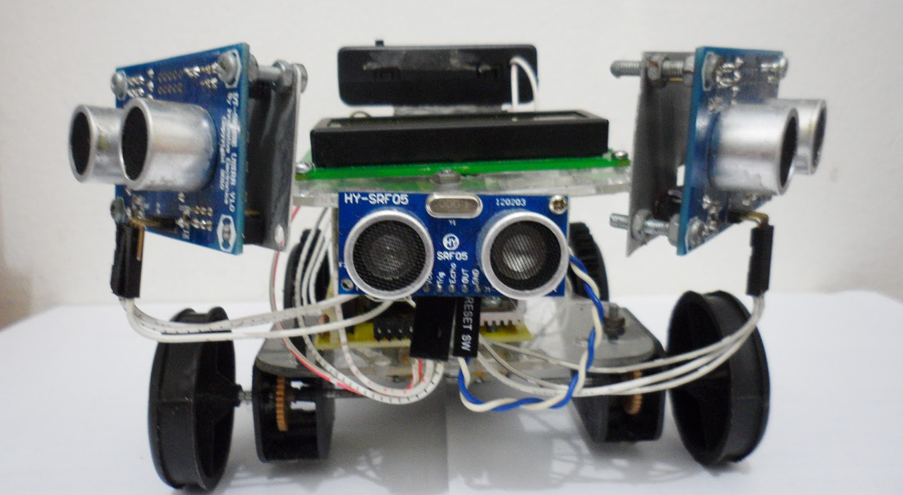
sensors
PROJECT
the sense is strong with this one
DATE
10/23/14
Client
bill bonner

Slide 2
Sense
Sense - a faculty by which the body perceives an external stimulus; one of the faculties of sight, smell, hearing, taste, and touch.
Sensor - a device that detects or measures a physical property and records, indicates, or otherwise responds to it.
(courtesy of google)

Slide 3
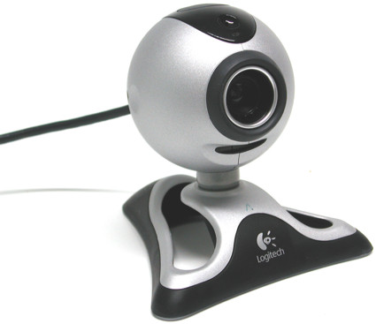
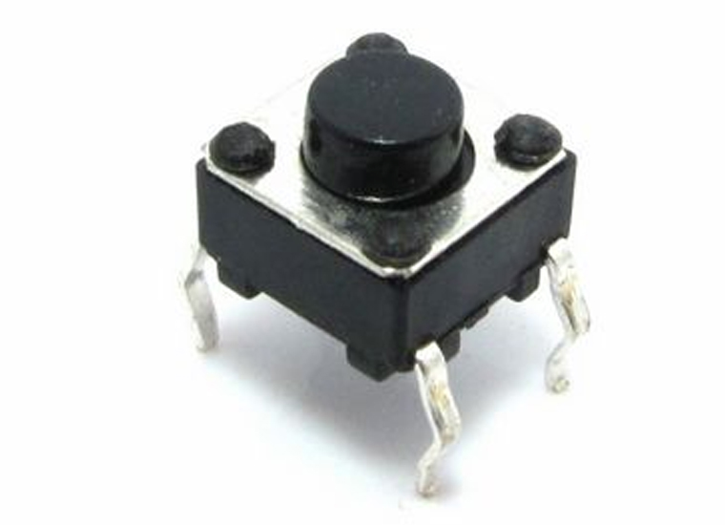
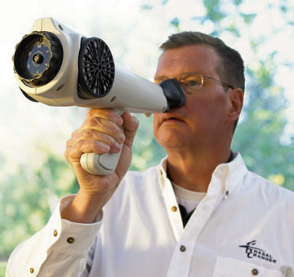
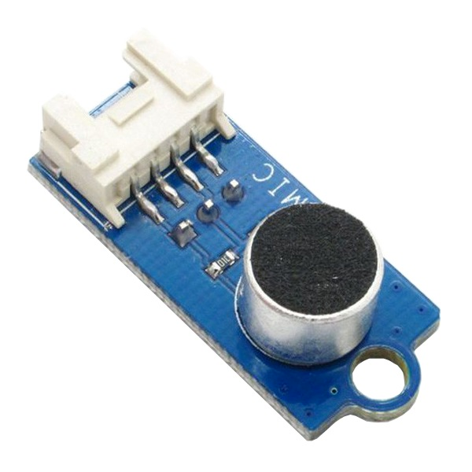
The Five Senses
Camera
Microphone
Button
Olfactometer

Slide 4
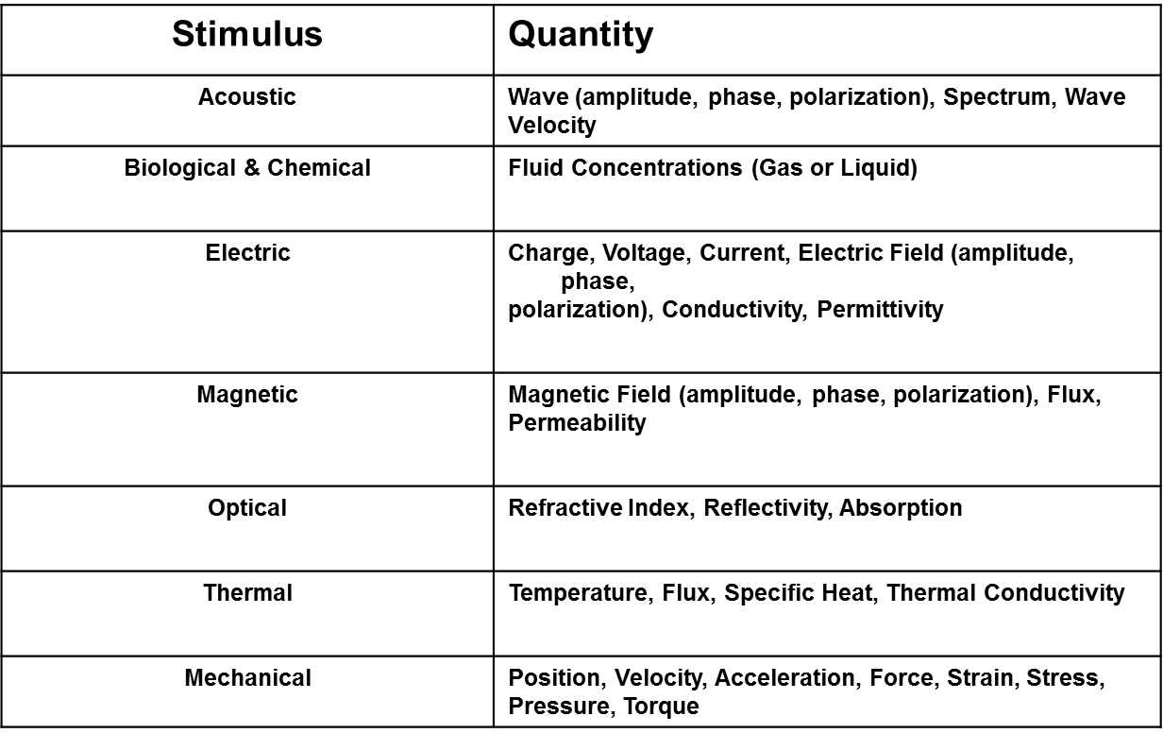
Measurable Stimuli

Slide 5
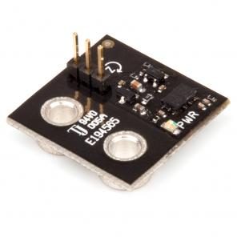
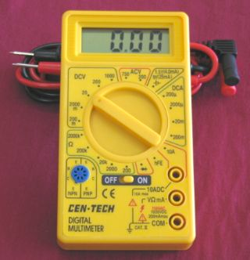
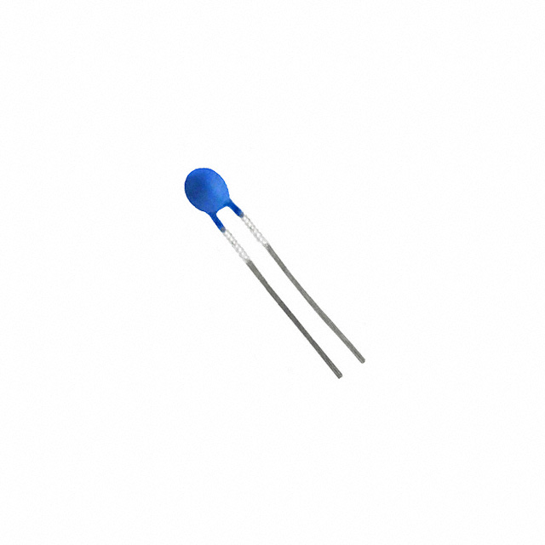
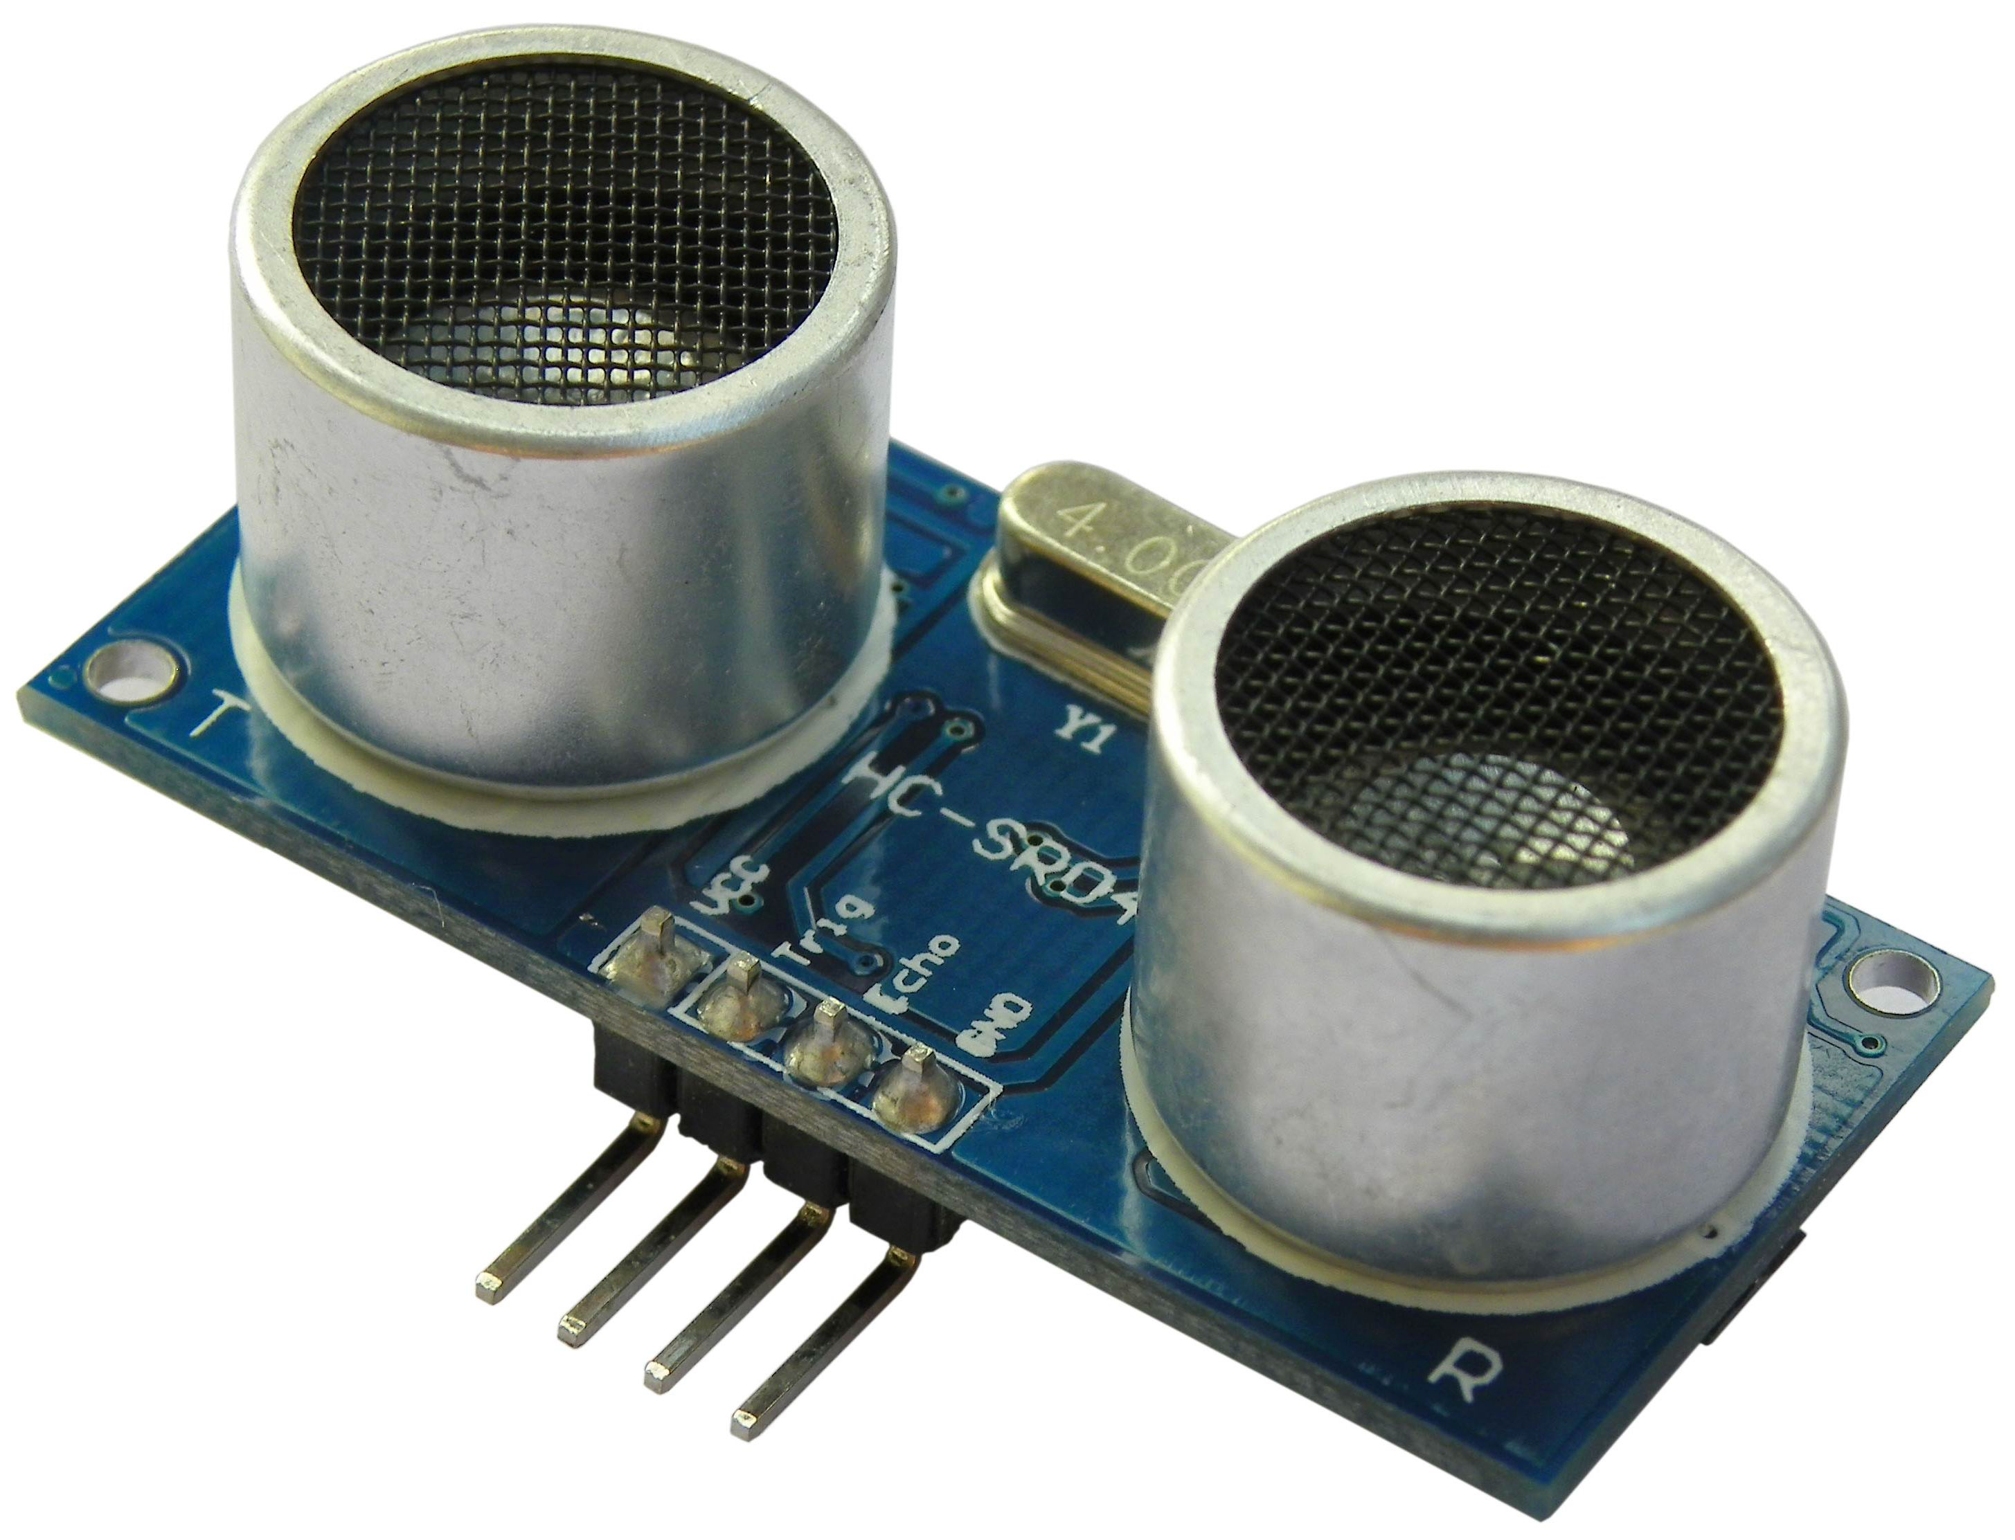
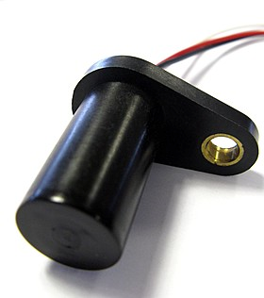
Robot Senses
Accelerometer/Gyroscope
Ultrasonic Rangefinder
Hall Effect Sensor
Voltmeter
Thermistor

Slide 6
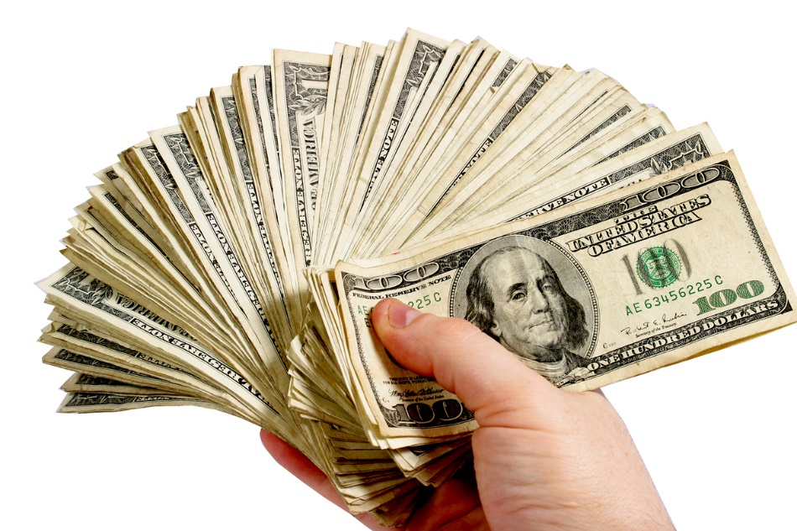
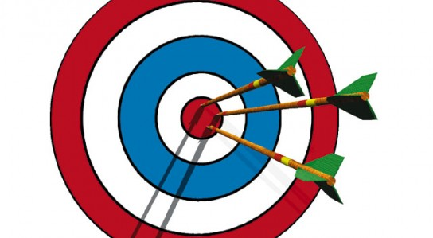
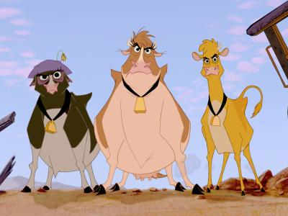
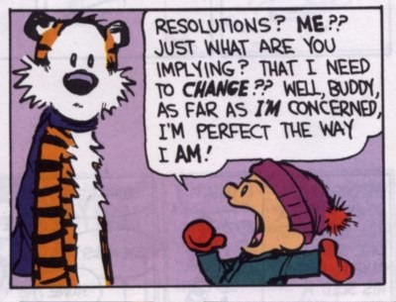
Choosing a Sensor
Accuracy
Calibration
Cost
Environment
Range
Repeatability
Resolution

Slide 7
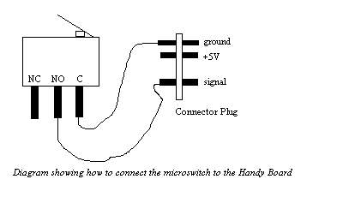
Today’s Sensors
Photoresistors
Light sensitive variable resistors with up to a Mohm in pitch black to a few hundred ohms in direct light
Microswitches
Limit switch with normally open and normally closed connections
Ultrasonic Rangefinders
Measures distance by the time it takes for a sound wave to be reflected back

Slide 8
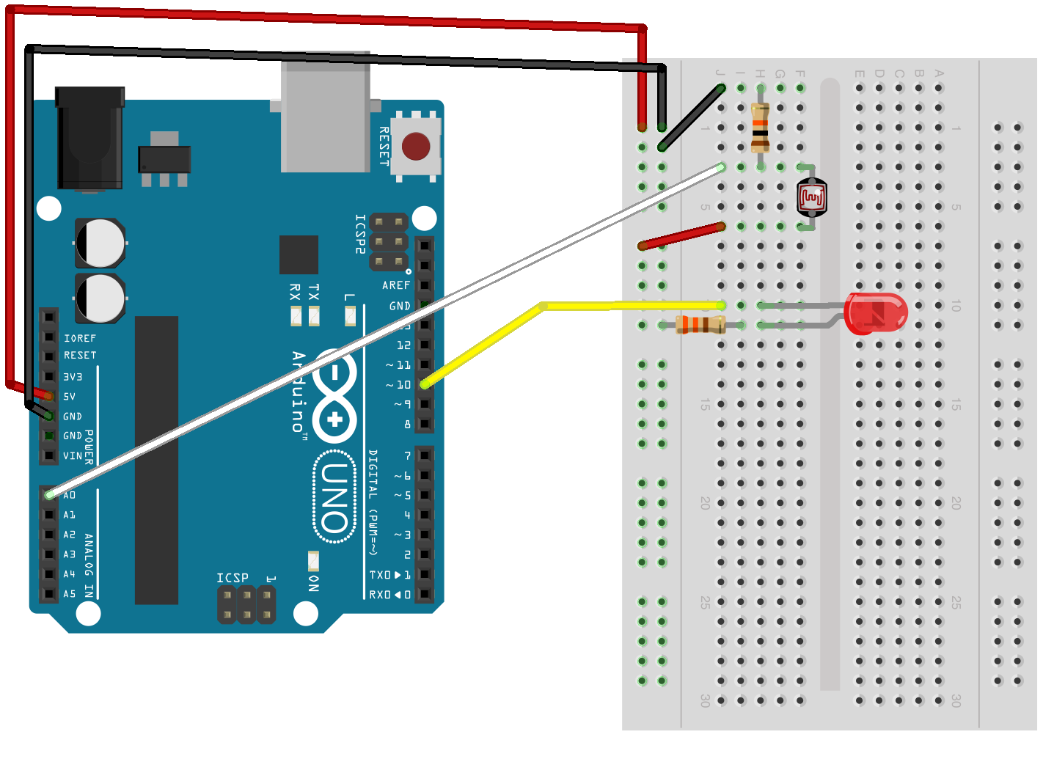
Projects - Beginner
Construct a circuit that will let the brightness of an LED be proportional to the photoresistor’s readings
Functions Needed:
analogRead()
analogWrite()

Slide 9
Projects - Intermediate
Make a brightness following robot using the robot bases we built in week 5 and photoresistors.
Make a wall following robot using the same robot base and microswitches.

Slide 10
Projects - Advanced
Make a wall following robot using an ultrasonic rangefinder.

